Slide 1
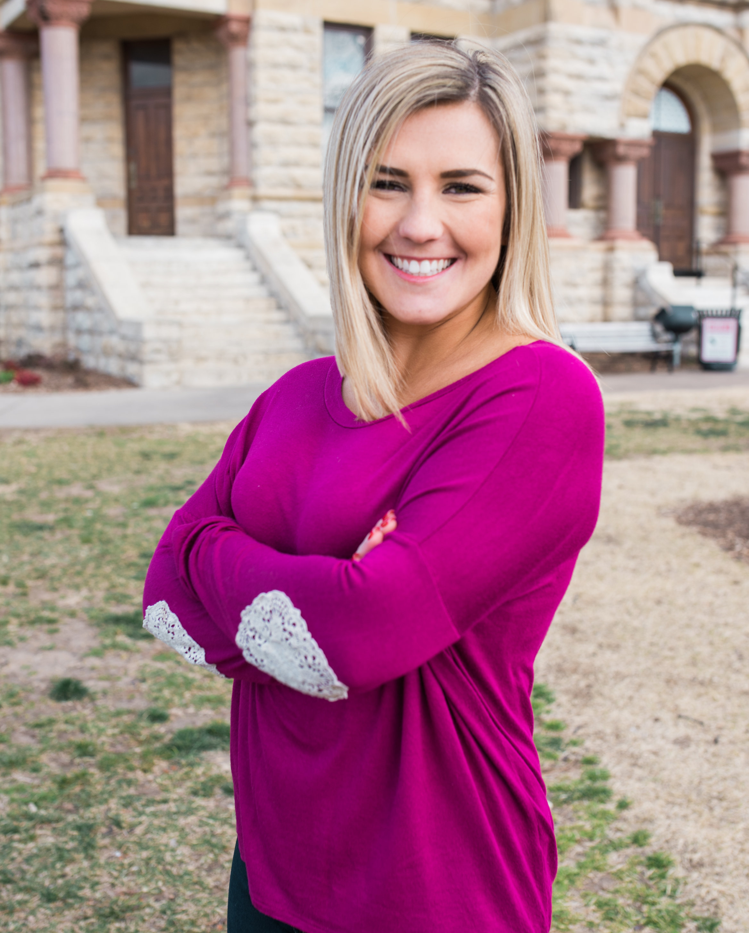
CAITLIN
Currently reading _________________ by ________________.
She has read ___ books this school year!
#ReadersAreLeaders

Slide 2
CAITLIN
Currently reading _________________ by ________________.
She has read ___ books this school year!
#ReadersAreLeaders

Slide 3
CAITLIN
Currently reading _________________ by ________________.
She has read ___ books this school year!
#ReadersAreLeaders

Slide 4
CAITLIN
Currently reading _________________ by ________________.
She has read ___ books this school year!
#ReadersAreLeaders

Slide 5
CAITLIN
Currently reading _________________ by ________________.
She has read ___ books this school year!
#ReadersAreLeaders

Slide 6
CAITLIN
Currently reading _________________ by ________________.
She has read ___ books this school year!
#ReadersAreLeaders

Slide 7
CAITLIN
Currently reading _________________ by ________________.
She has read ___ books this school year!
#ReadersAreLeaders

